Slide 1
Nodal Analysis for DC source
Nokibul Arfin Siam
ID: 21-44793-1.
Introduction to electrical circuit
Section: K.

Slide 2
Table of Content
Definition of Nodal Analysis.
Steps of Nodal Analysis.
One solved problem of nodal analysis.
Conclusion.

Slide 3
Definition of Nodal Analysis.
Nodal analysis is a method that provides a general procedure for analyzing circuits using node voltages as the circuit variables. Nodal Analysis is also called the Node-Voltage Method.

Slide 4
Steps of Nodal Analysis.
Determine the number of nodes within the network.
Pick a reference node, and label each remaining node with a subscripted value of voltage: V1 , V2 , and so on.
Apply Kirchhoff’s current law (KCL) at each node except the reference. Assume that all unknown currents leave the node for each application of Kirchhoff’s current law (KCL). Each node is to be treated as a separate entity, independent of the application of KCL to the other nodes.
Solve the resulting equations for the nodal voltages.

Slide 5
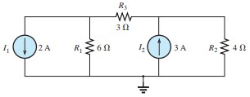
One solved problem of nodal analysis
Problem: Find the voltage across using nodal analysis.

Slide 6
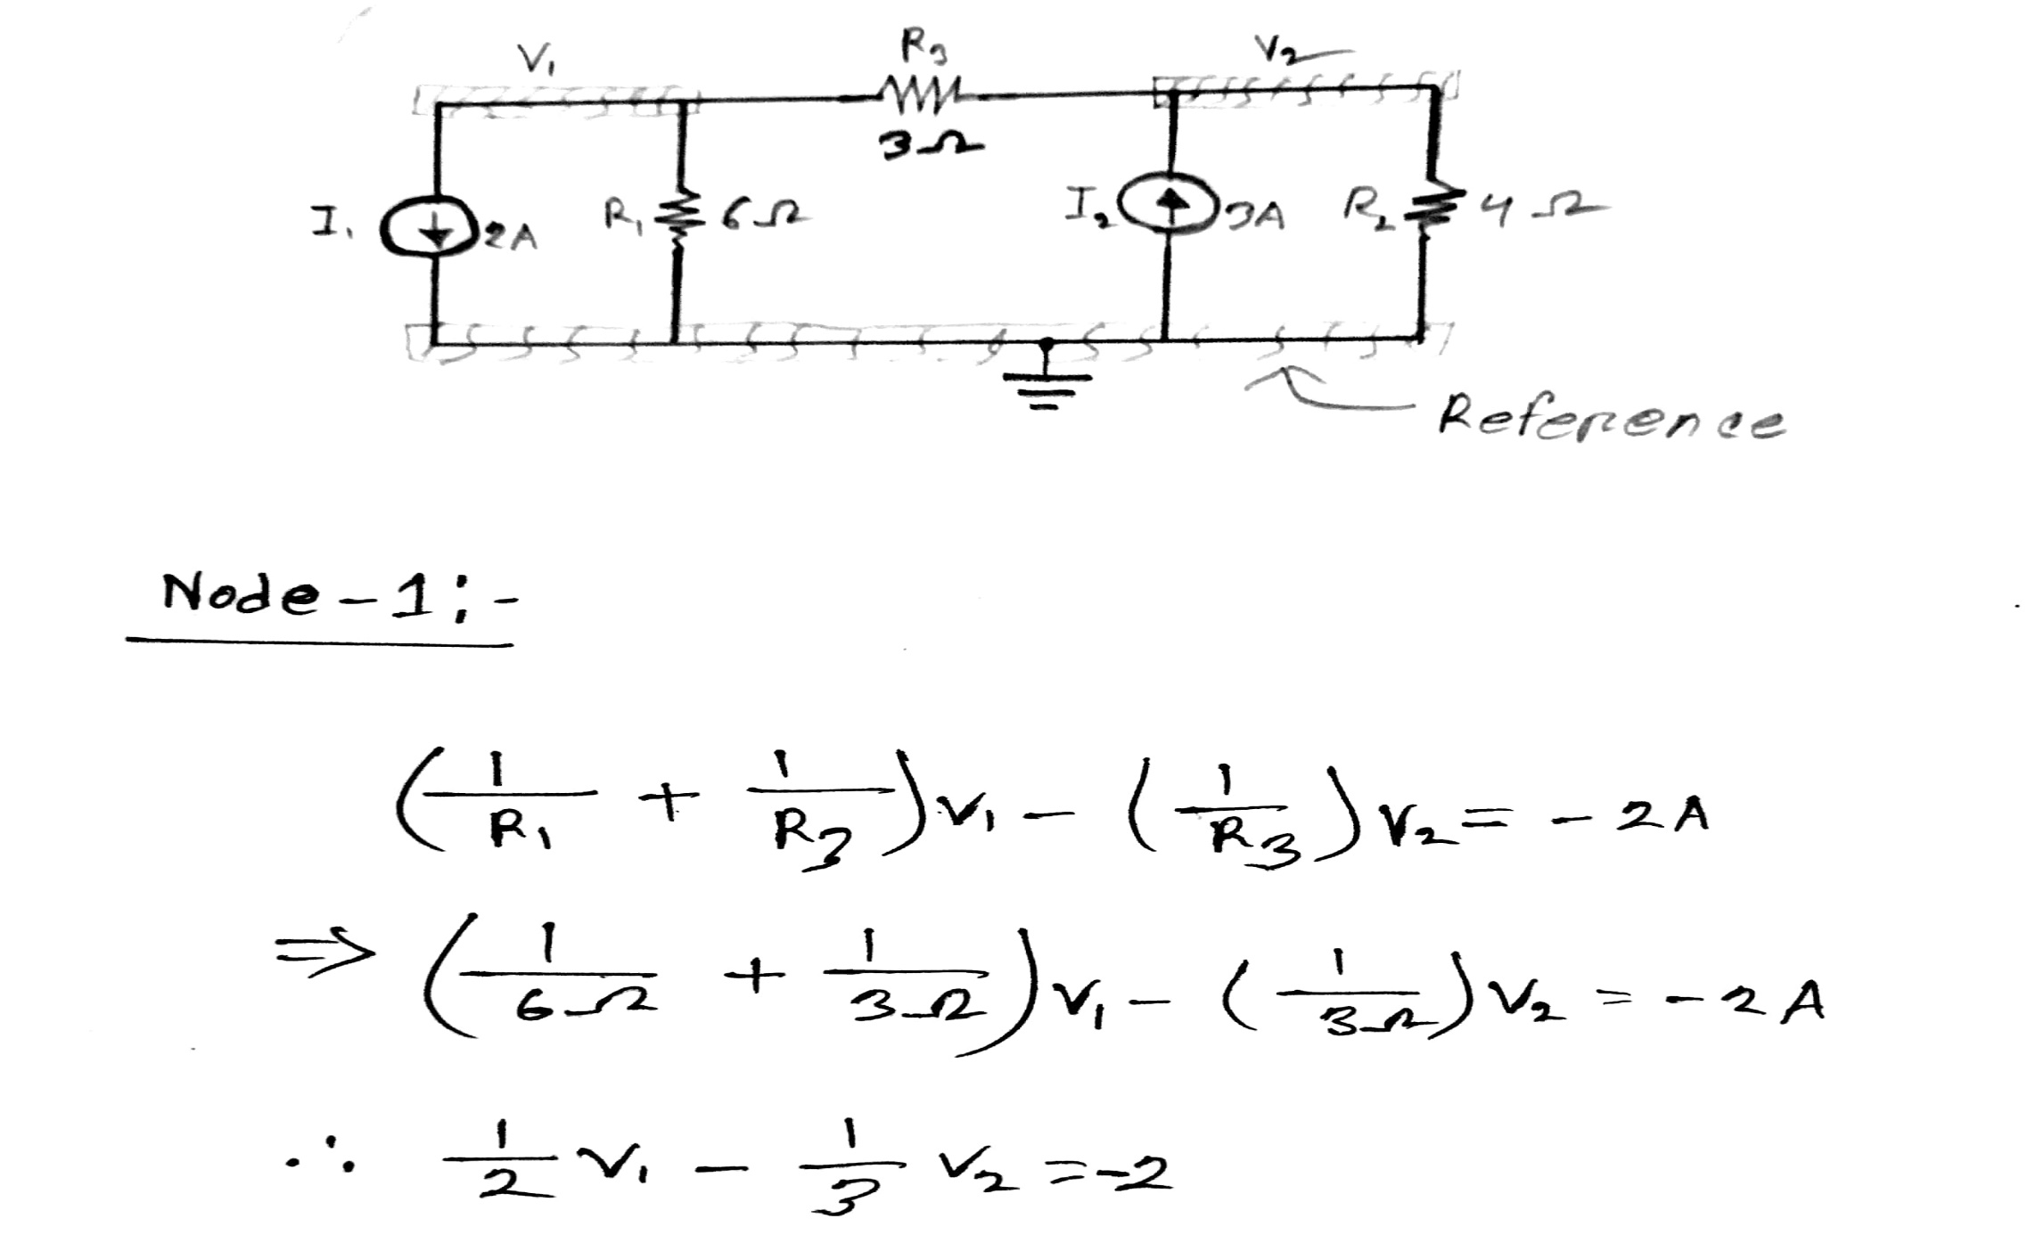
Solution:

Slide 7
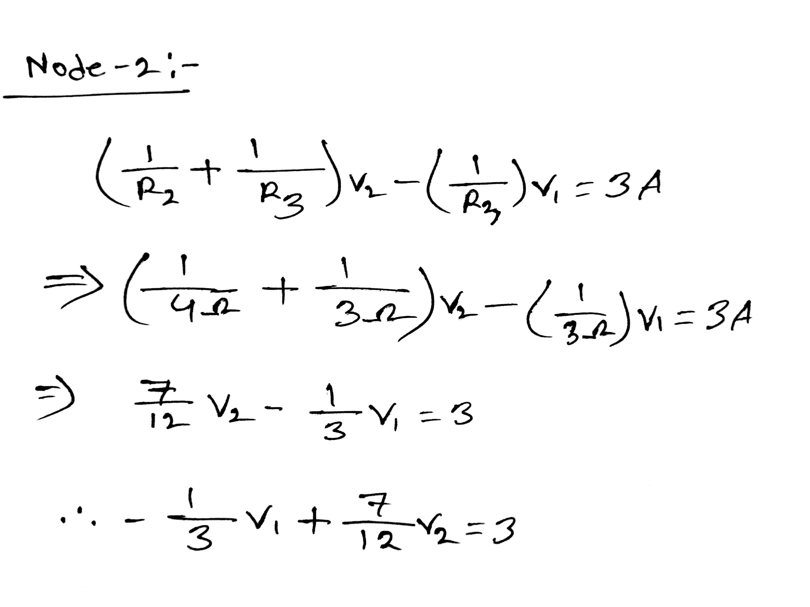

Slide 8
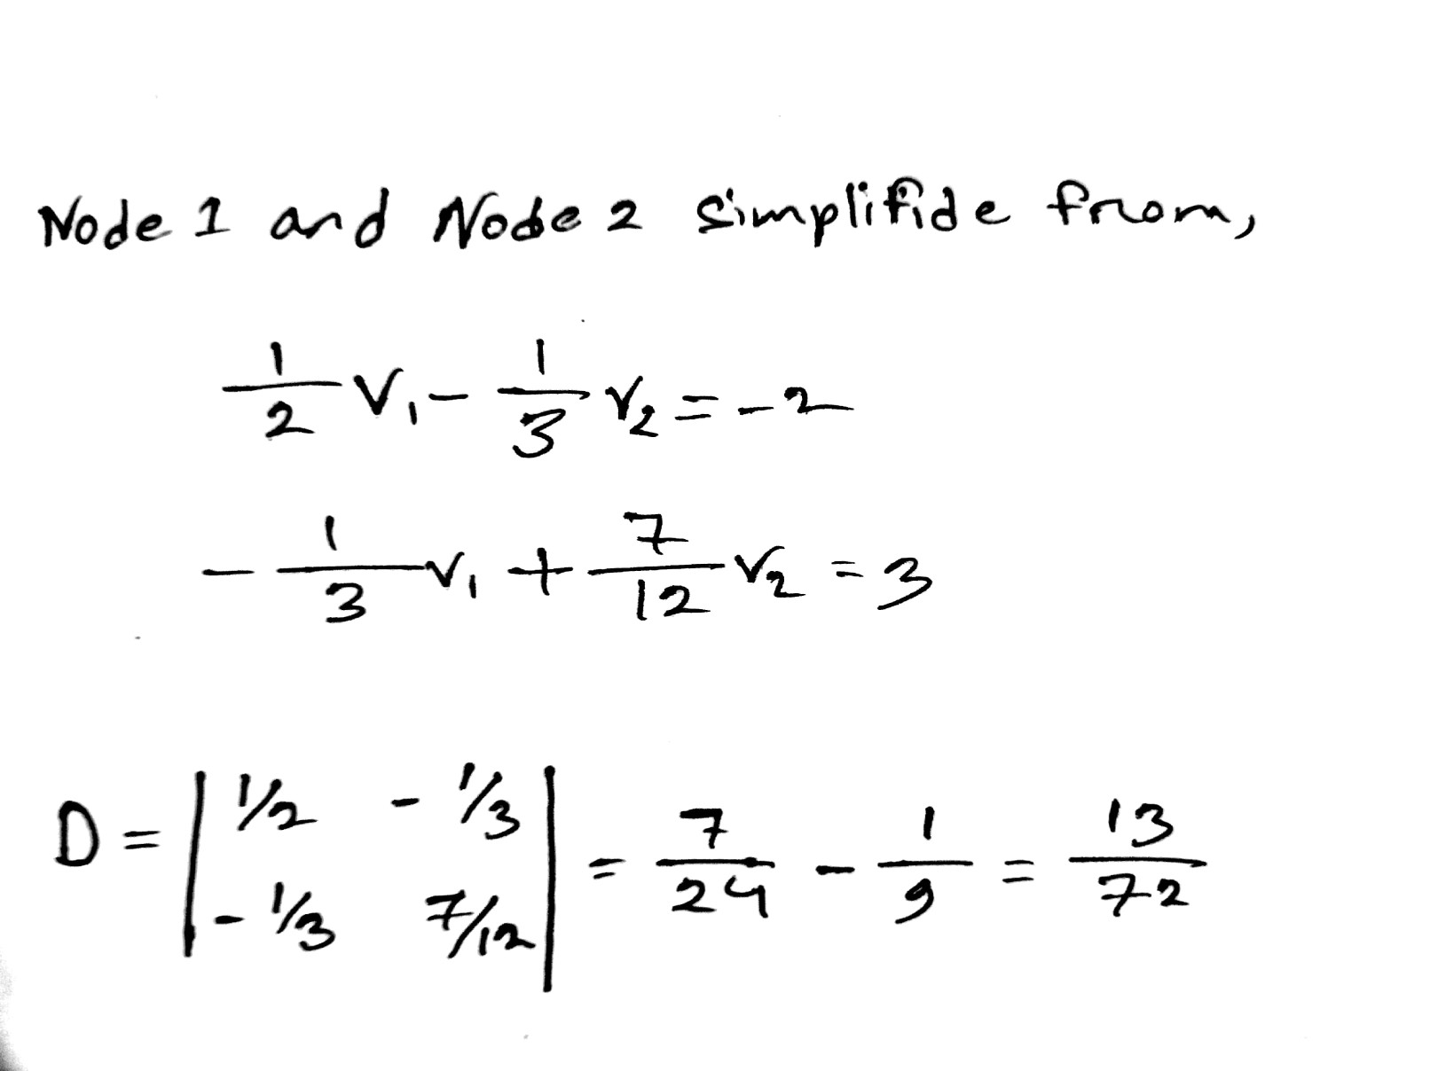

Slide 9
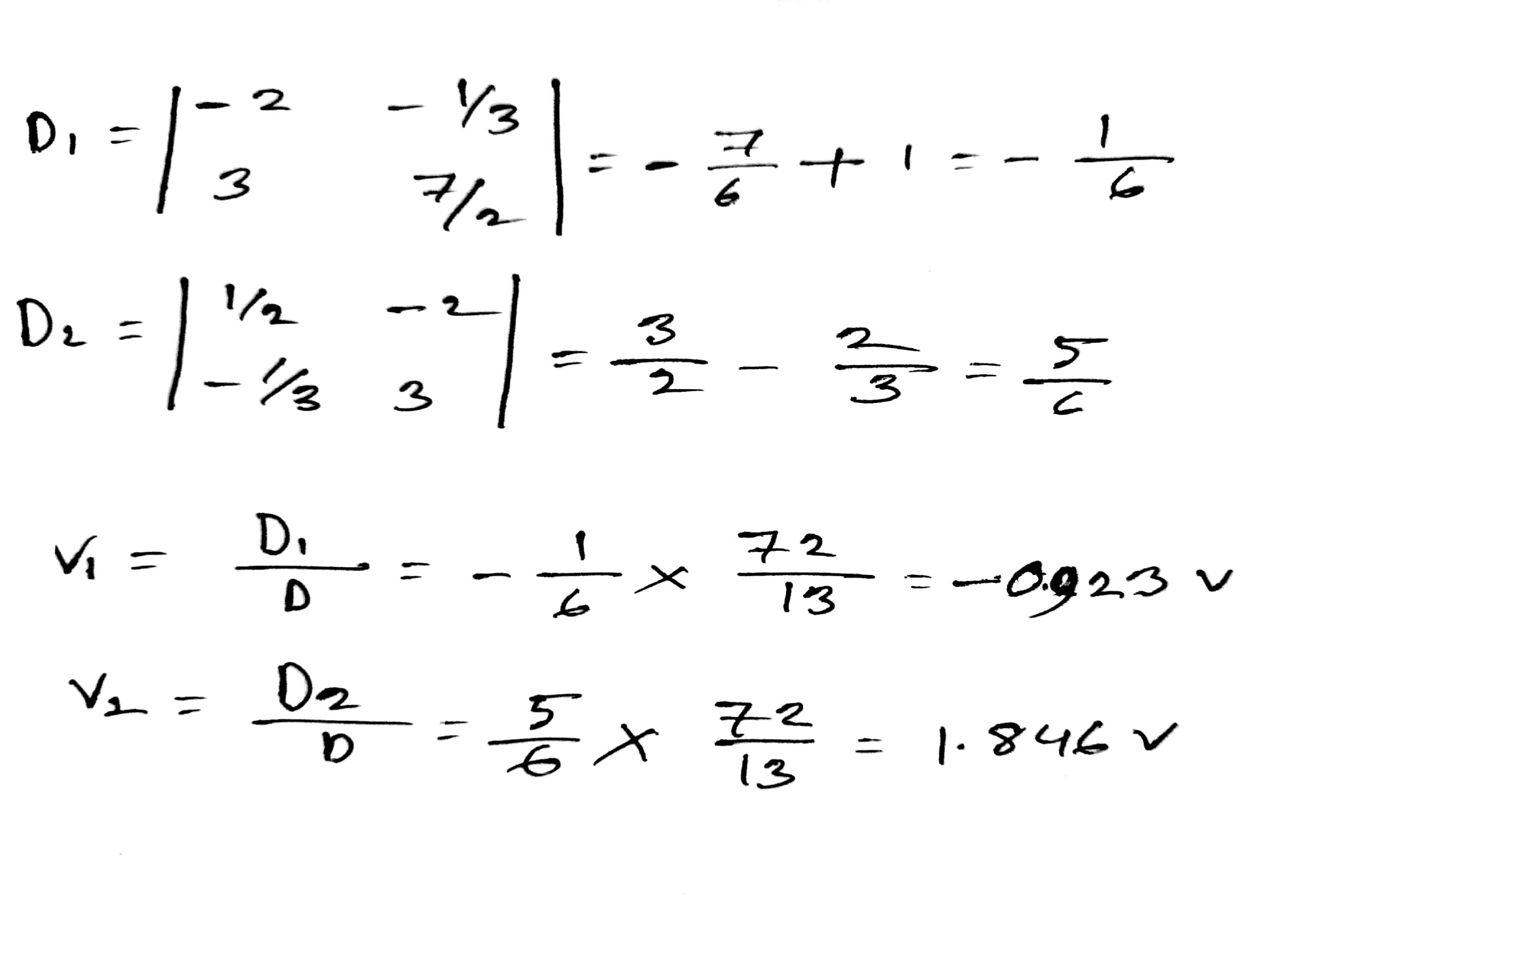

Slide 10
Conclusion
Nodal analysis method is studied as a key tool to analyze any circuit.
Basic nodal analysis steps is introduced highlighted by examples

Slide 11
THANK YOU

